Slide 1
Insperity/Eventeny Policies & General Updates

Slide 2
Agenda
Travel: Domestic and International
PTO/Time Tracking in Insperity
Conference and miscellaneous travel
Other Announcements and Q&A

Slide 3
Keep in mind
We will not be naming names in the chat or otherwise
If you think that you or another teammate are in violation of any of these policies please speak directly and privately with your manager

Slide 4
Travel: Domestic
Domestic travel is within the United States this includes Hawaii, Alaska, The US Virgin Islands and Puerto Rico
For insurance purposes domestic travel should be reported to your manager
If your physical location differs from your Insperity address for more than 30+ days at a time, you need to alert your manager

Slide 5
Travel: International
Any international travel needs to be reported to your manager- domestic travel should also be reported especially if it will interfere with work
Upon employment everyone e-signed a document agreeing that working for 30+ consecutive days out of the US is a violation of Eventeny policy
That agreement also states that no employee may spend 120 or more days traveling outside of the US in a 12 month period- this does not restart per calendar year, this is a rolling number
Violation of these policies can lead to termination- this has a lot to do with Eventeny violating tax law and US workers law, all of which is out of Eventeny’s hands

Slide 6
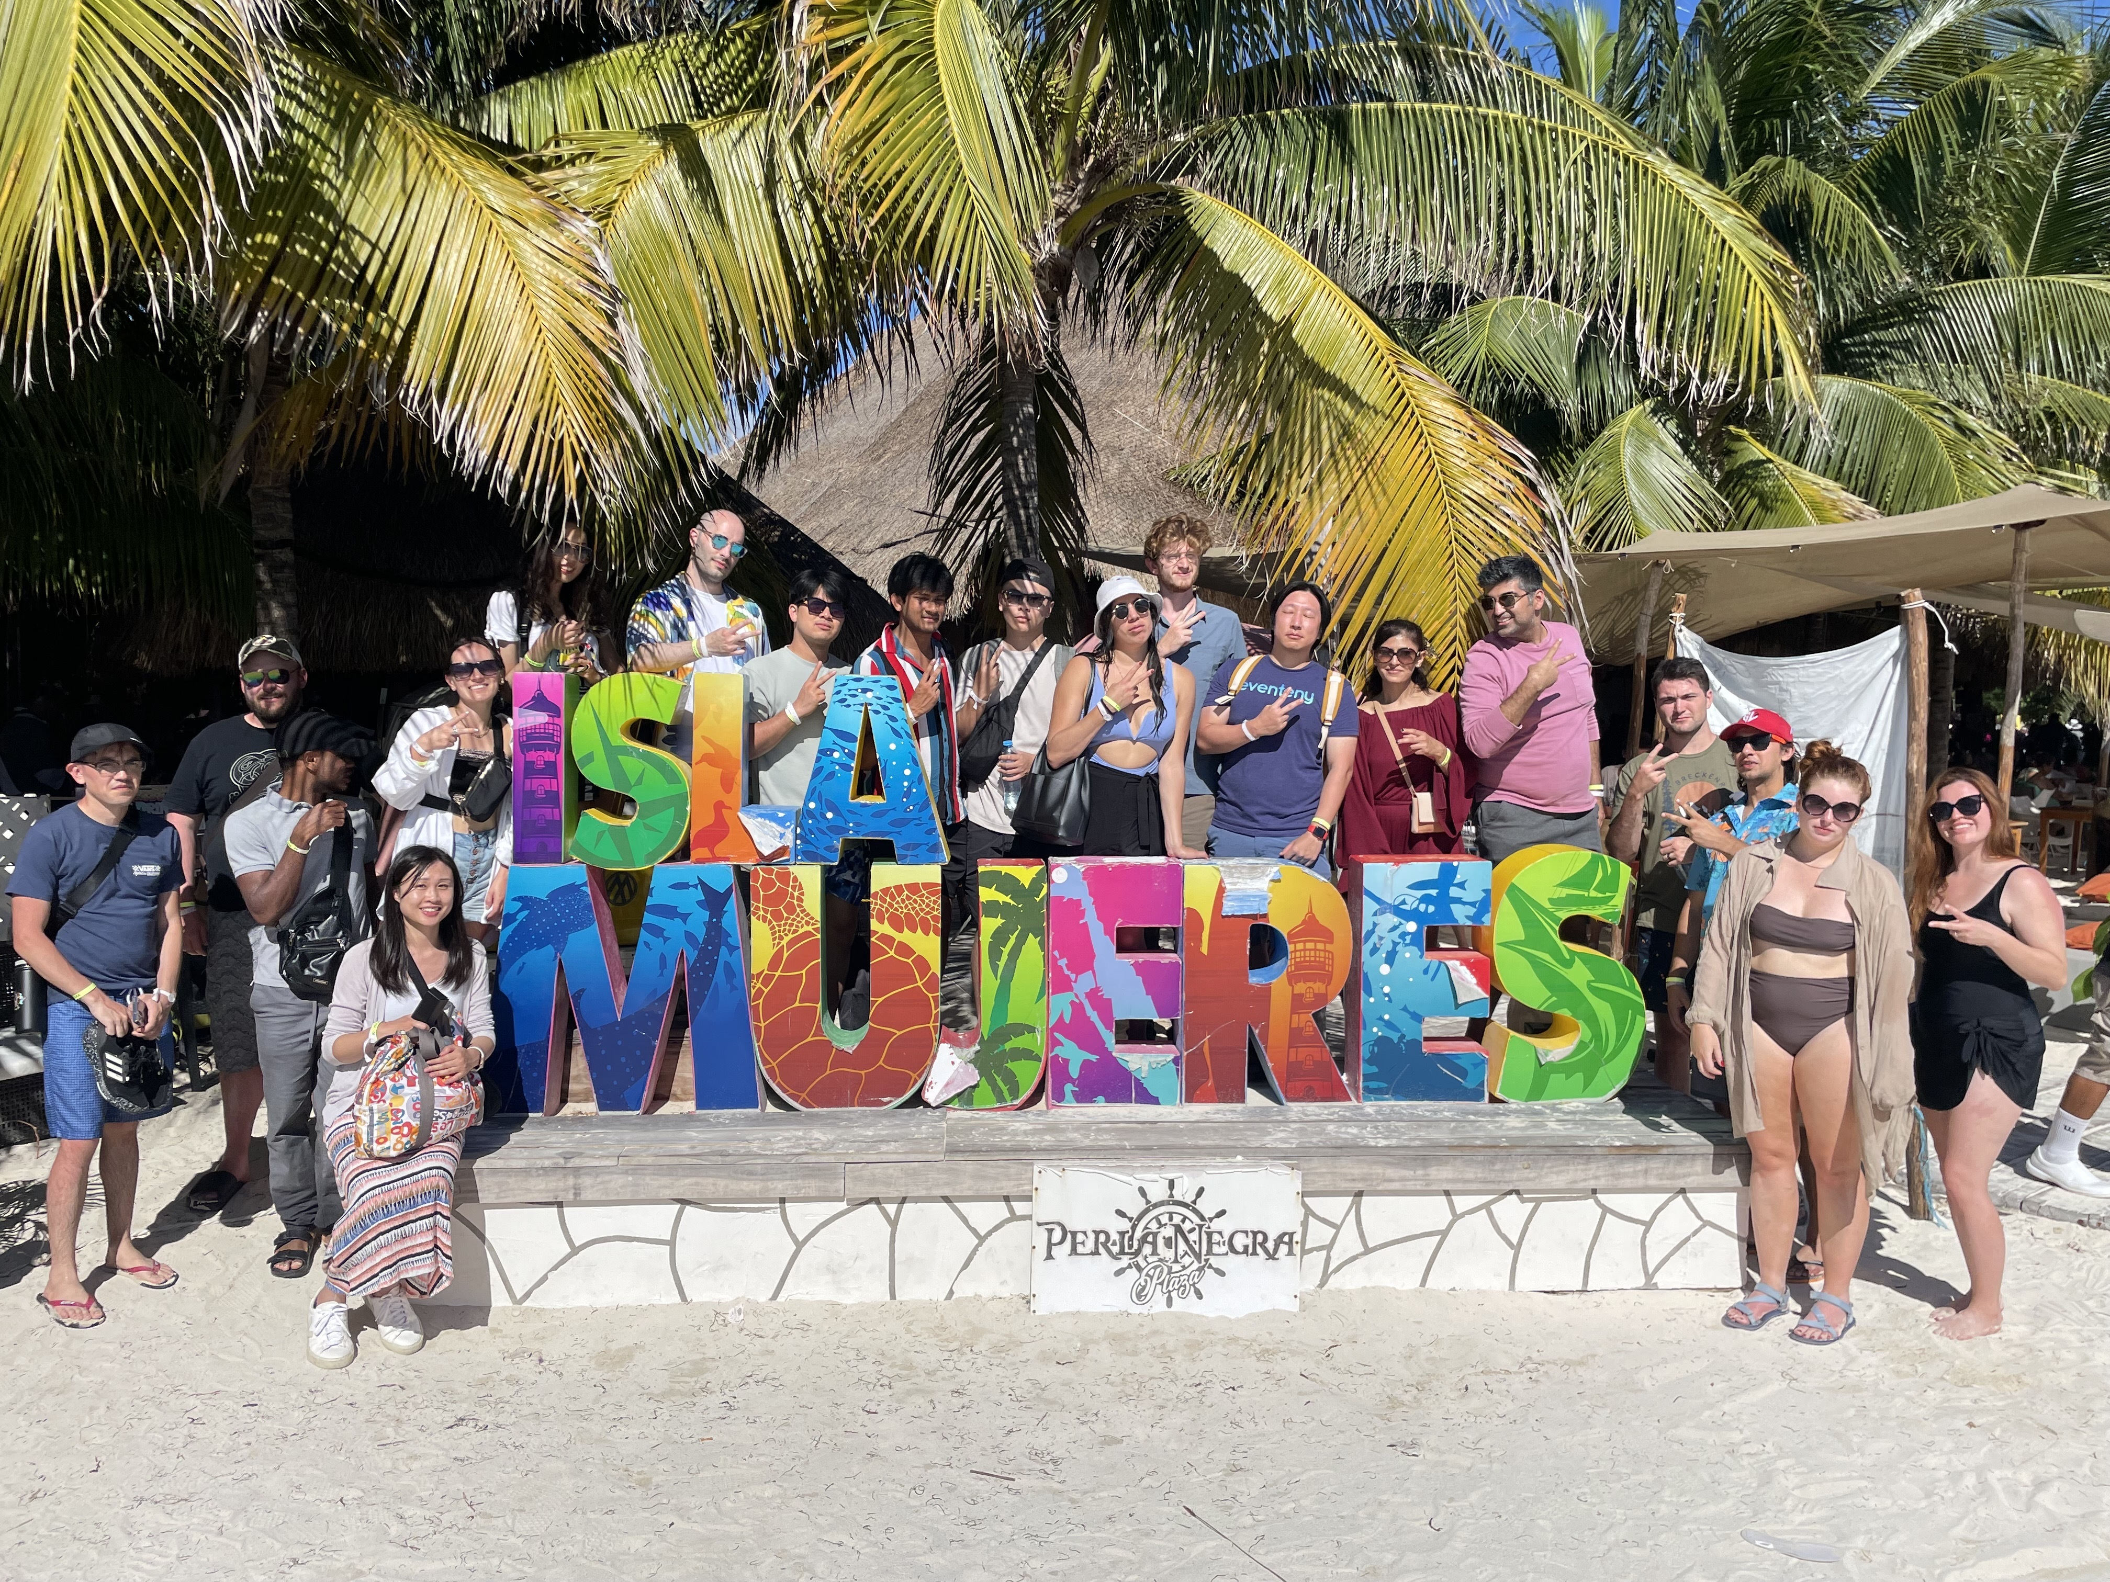
Travel: International
Retreat days count towards 120
We still fully encourage travel- that’s one reason why we are remote!
Be transparent with your manager
Specific questions: talk to manager

Slide 7
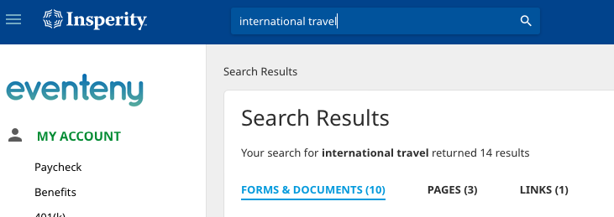
How to request international travel:
Log into portal.insperity.com
Search for "International Travel"
Click on "Links"
Click on "International Travel Notification Form"

Slide 8
PTO/ Time Tracking in Insperity
Begins Saturday, December 16th

Slide 9
PTO/ Time Tracking
PTO is for any full time employees
Time Tracking is for any part-time hourly employees
Lunch punches is for any part-time hourly California employee
Eventeny Useful Links will be updated with directions asap

Slide 10
Part-Time/Hourly Time Tracking
California part time employees must clock out for at least a 30 minute lunch if you work over 6 consecutive hours
All other part timers do not need to track lunch
Work with your manager individually to find what works best (weekly hours review, biweekly, or submitting and letting the manager approve from Insperity)
If you missed the part timers training or need a refresher please slack me before December 16th

Slide 11
Conference & Misc. Travel
Any discrepancy in your accommodations: delayed flight, cancelled flight, hotel reservation problem, etc. needs to be reported to your manager and to Jaylyn
Eventeny is not responsible for: room upgrades, mini bars/alcohol, stay extensions, flight upgrades, shopping, excessive meal spending (unless prior approval), pay-per-view, spouse meals/accommodations
If prompted to put your CC down for incidentals, you will need to

Slide 12
Other reminders
Open Enrollment is now available on Insperity: look for an email from me for more details
Secret Santa
Zoho ”How to”: coming soon!
Spencer Ingle’s presentation Dec 12th at 3pm
Closed: December 22nd and 25th and January 1st

